Slide 1
AR Indoor Navigation for
SKKU Suwon campus
team E: 김현호 마준서 안정민 조민구

Slide 2


AR Environment
2/12

Slide 3
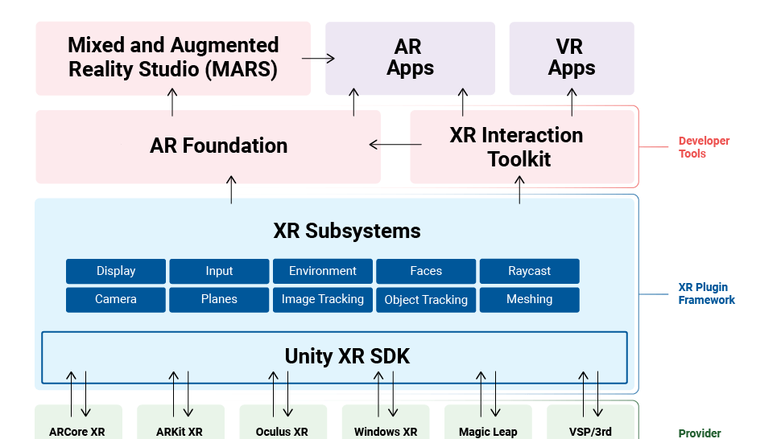

AR Environment
3/12

Slide 4
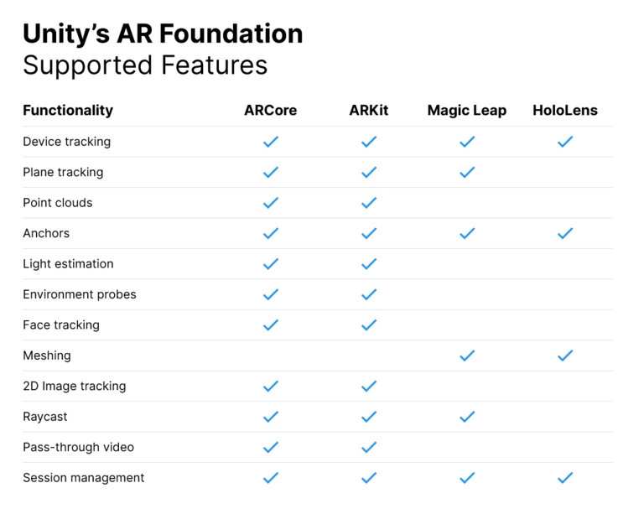
AR Environment
4/12

Slide 5

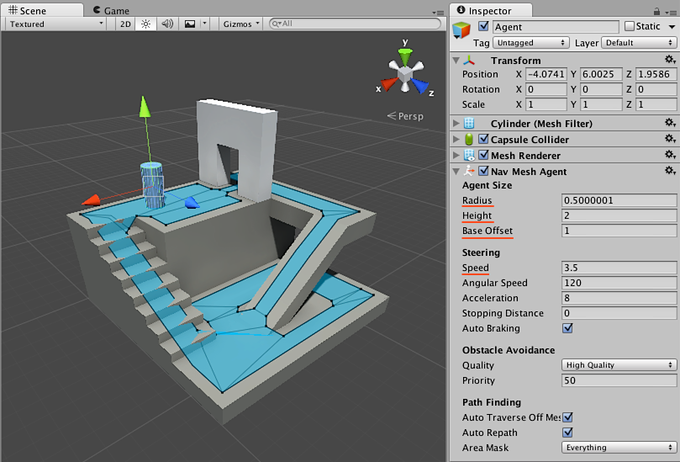
AR Environment
5/12

Slide 6



AR Marker Recognition
6/12
build: 27
floor: 3
room: 30

Slide 7
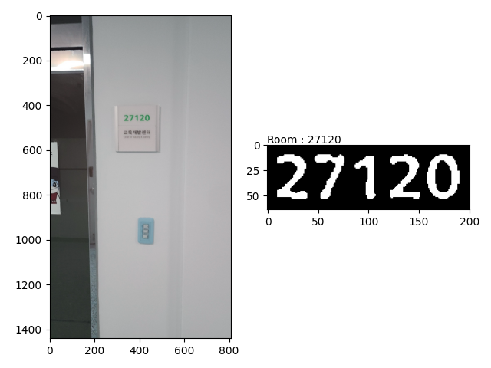
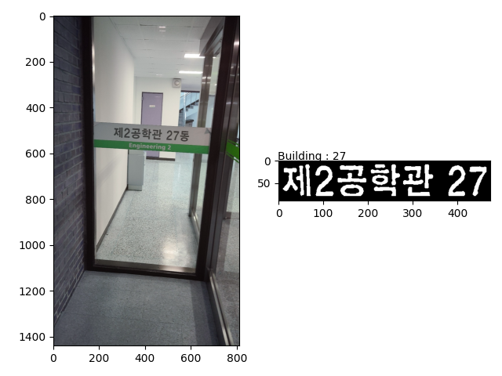
AR Marker Recognition
7/12

Slide 8
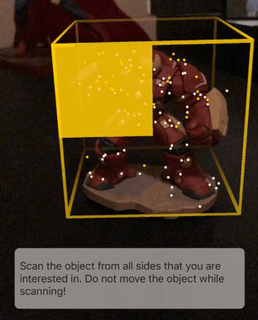
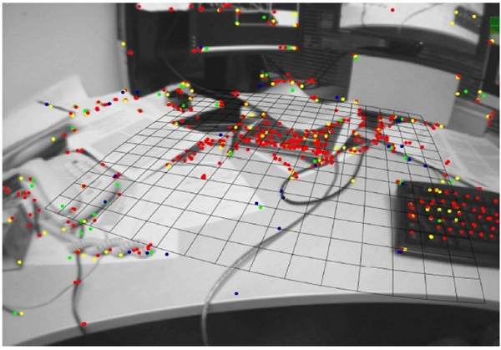
AR Anchor
8/12
Trends of VR/AR Game Technology(2016)

Slide 9
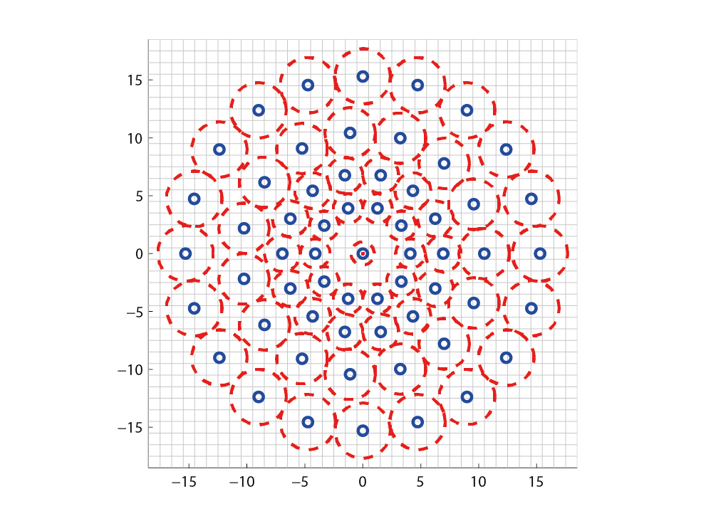
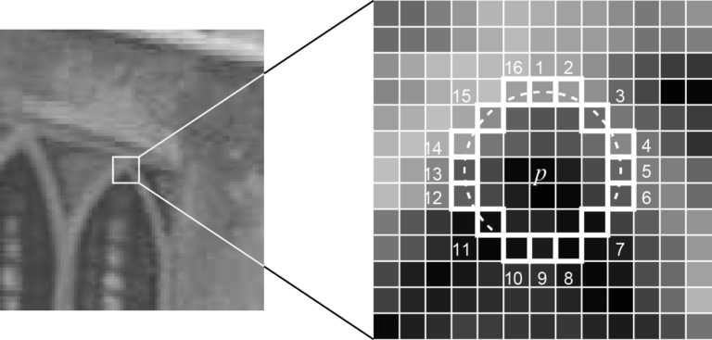
AR Anchor
9/12
Machine Learning for High-Speed Corner Detection(2006)
BRISK: Binary Robust invariant scalable keypoints(2011)

Slide 10
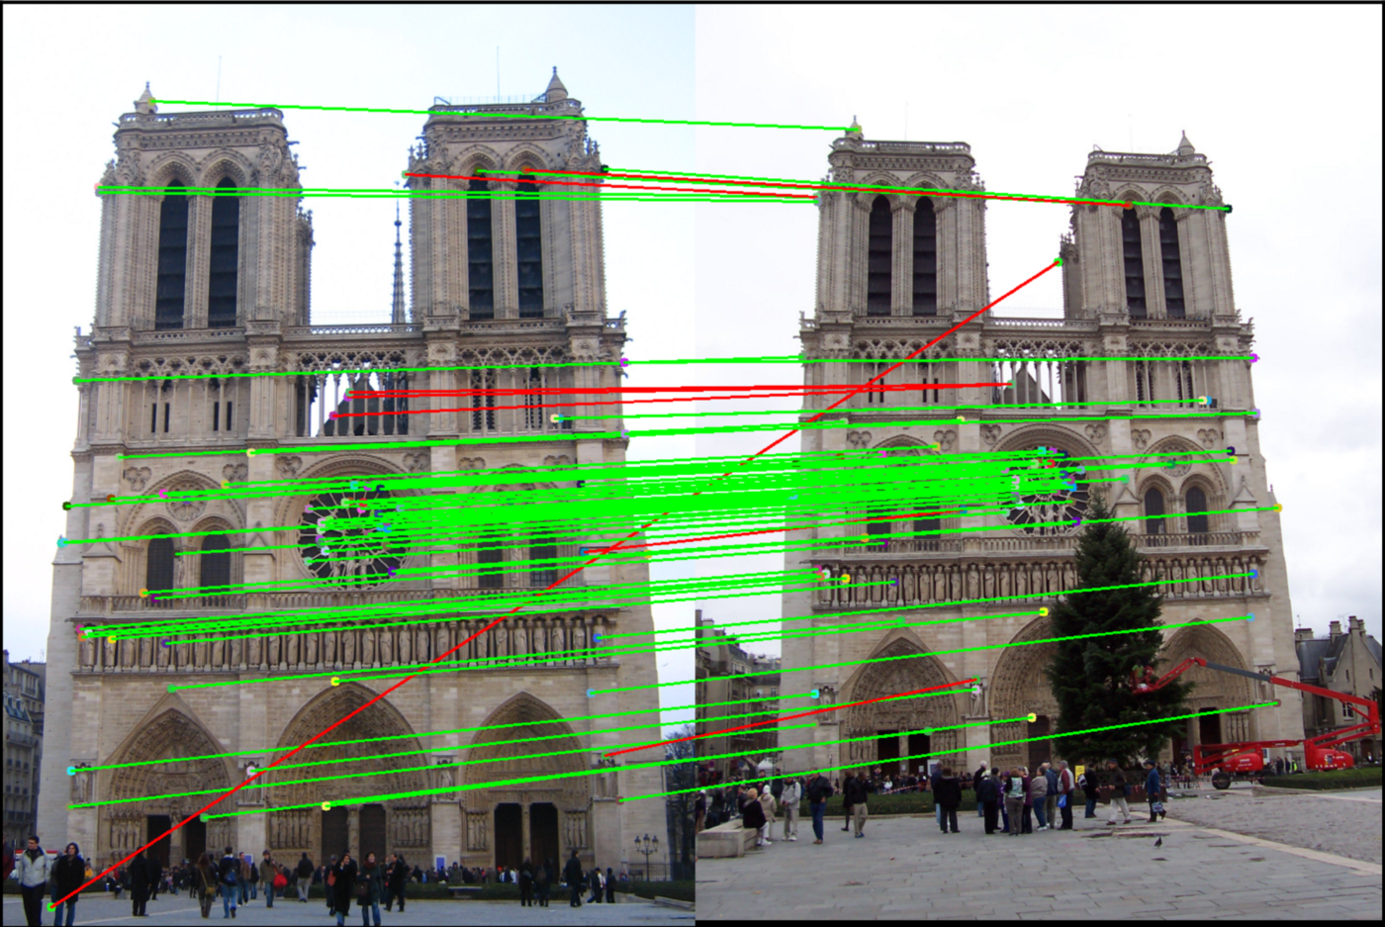
AR Anchor
10/12
BRISK: Binary Robust invariant scalable keypoints(2011)

Slide 11
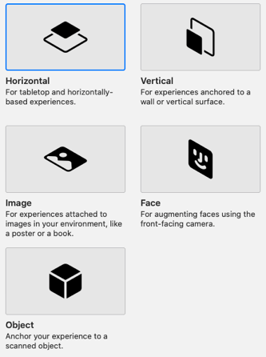
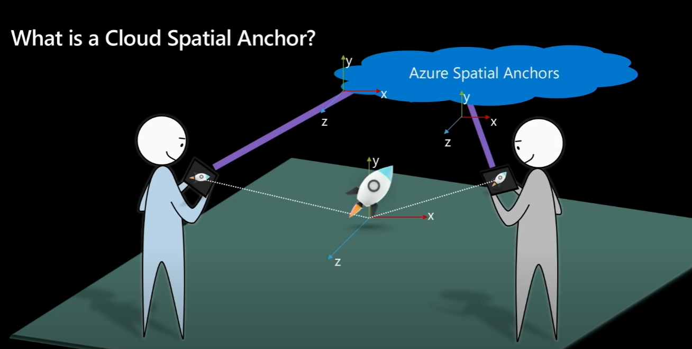
AR Anchor
11/12

Slide 12
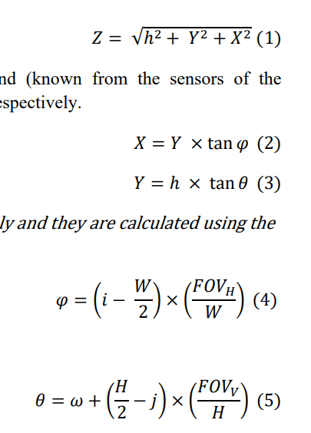

AR Anchor
12/12
Z: distance between camera and point
h: height of camera
: vertical angles
: rotation angles
DEPTH AND GEOMETRY FROM A SINGLE 2D IMAGE USING TRIANGULATION. (2012)

